Slide 1

Agenda for 3th Arrangement of Membership Roll Meeting
Date : 25-Aug-2024
1) Opening Prayer Rev. Lee
2) Membership Guideline Procedure 会员指南程序
3) Report Collection for conference commitment
4) New Members in Year 2023 September to 2024 August
5) Membership Database completed
- Love gift to Jenny Law
6) Filter up the Active/Inactive Membership List & Active/Inactive Probationary Members List

Slide 2
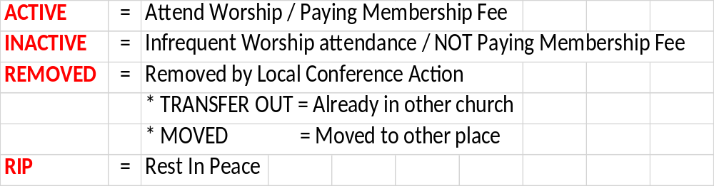
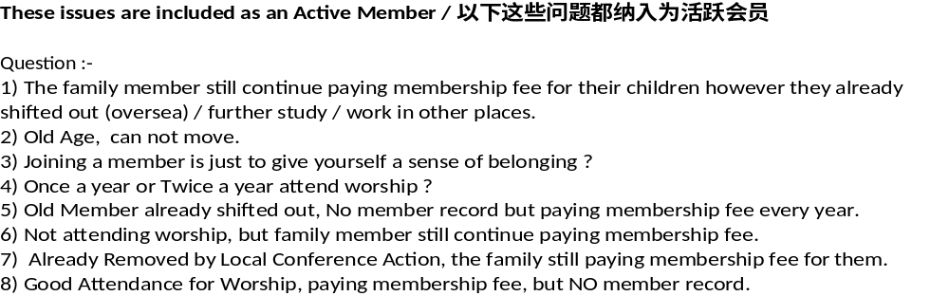

Slide 3

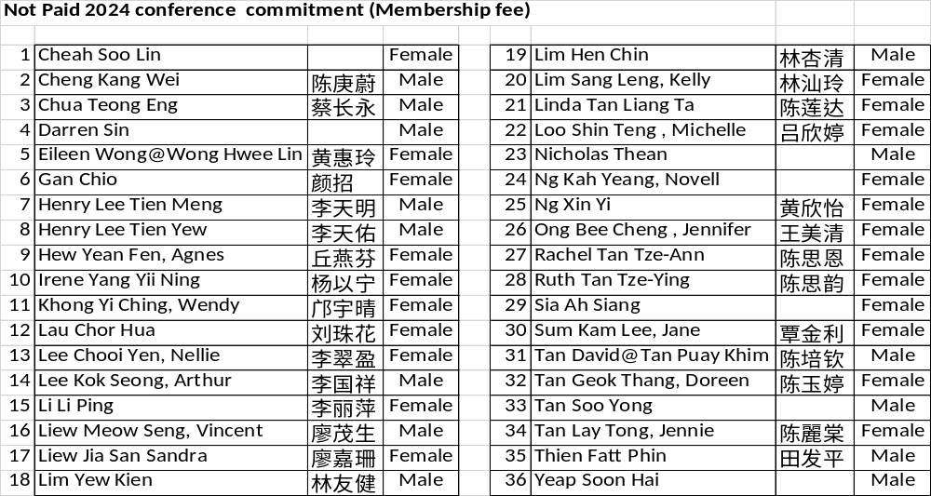

Slide 4
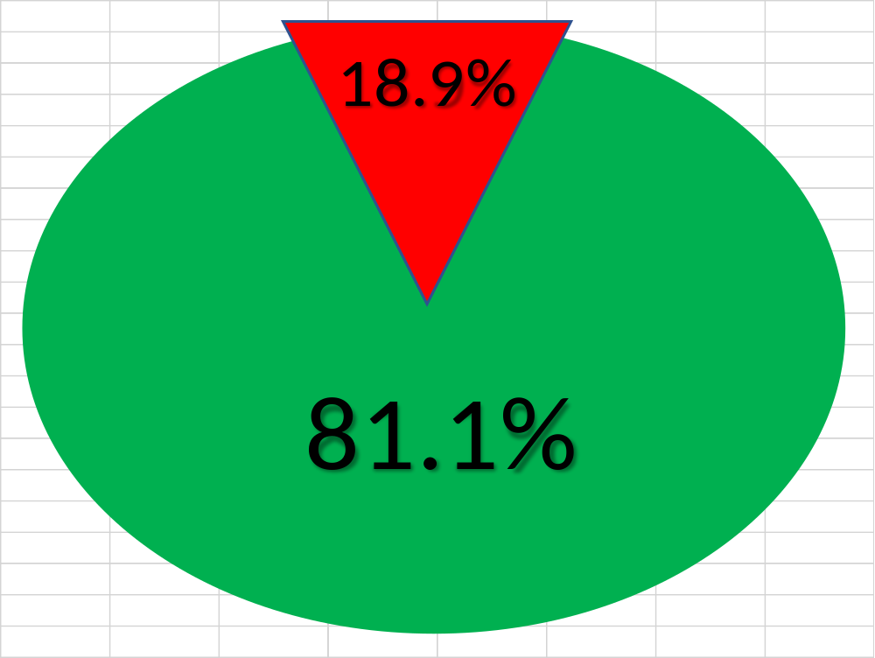
Here are the charts year 2024 collection for conference commitment
Total members = 238
Received Member fee = 202
NOT Received Member fee = 36

Slide 5
Member in year 2022 Sept to 2023 Aug
Active Membership Total : 234
Inactive Membership Total : 29
Active Probationary Members Total : 30
Inactive Probationary Members Total : 21

Slide 6
统计表人数纪录
2023年9月 到 2024年8月

Slide 7
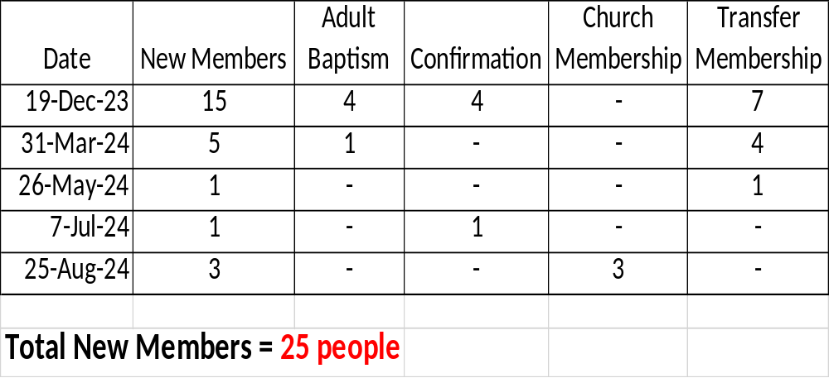
4) New Members in Year 2023 September to 2024 August

Slide 8
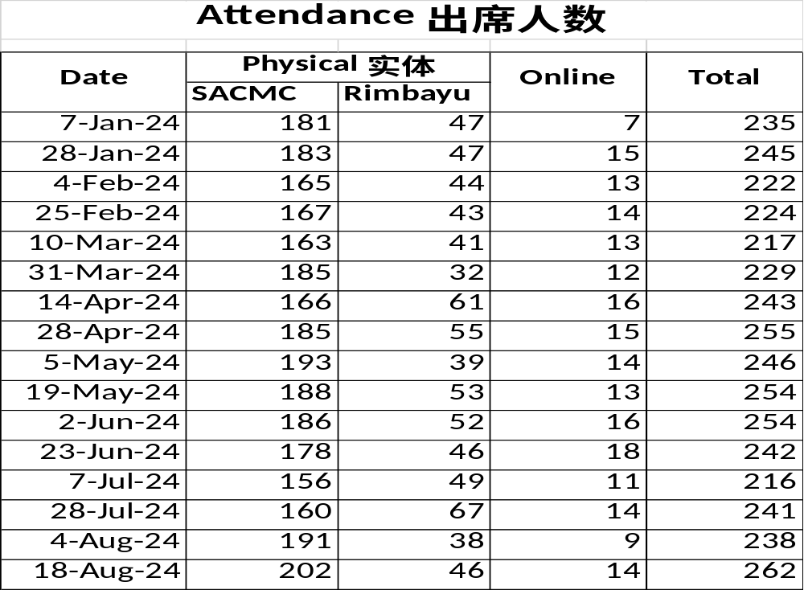

Slide 9
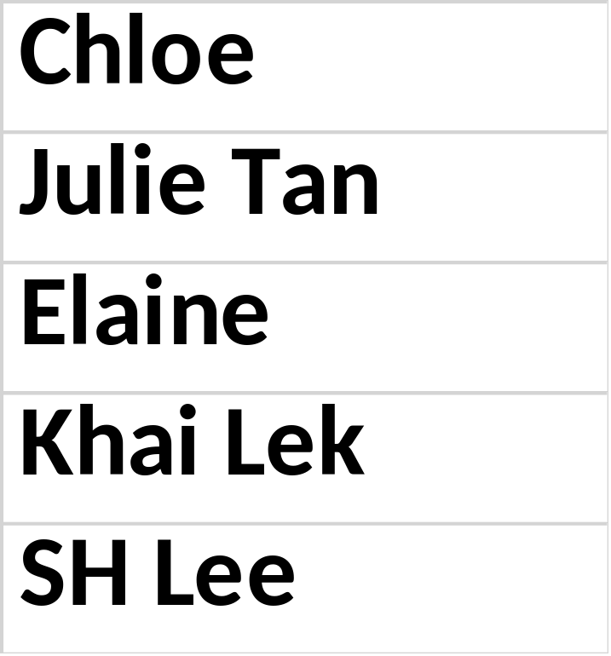
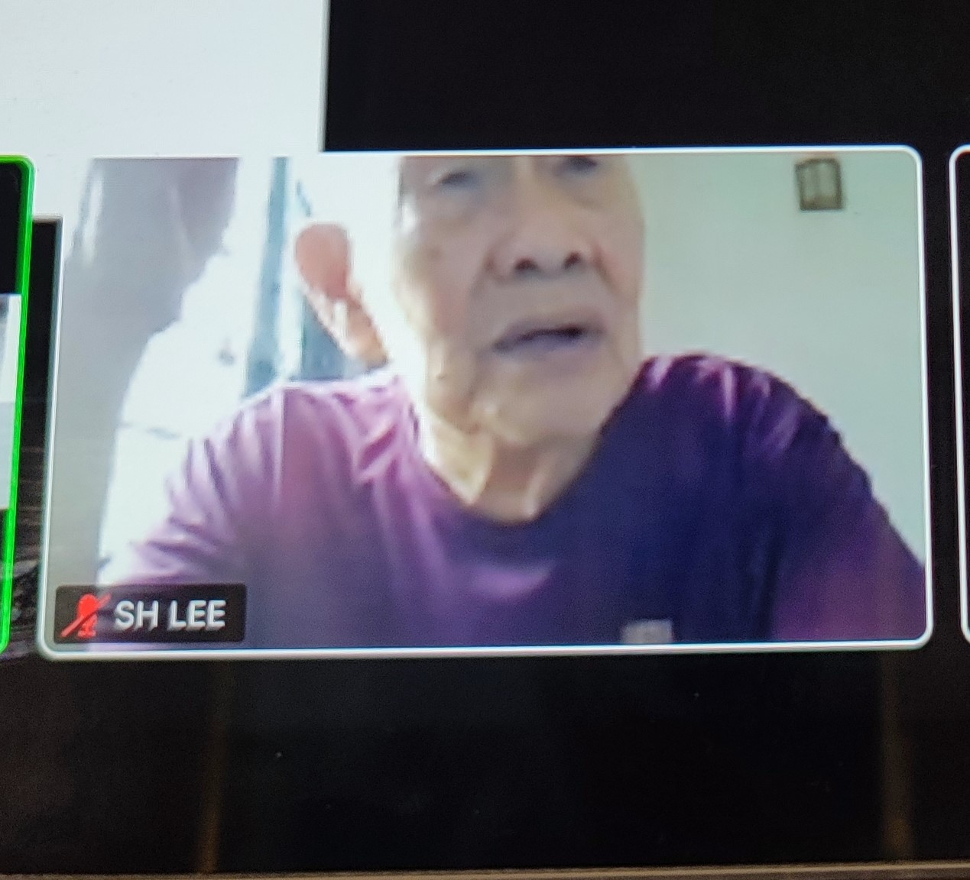

Slide 10
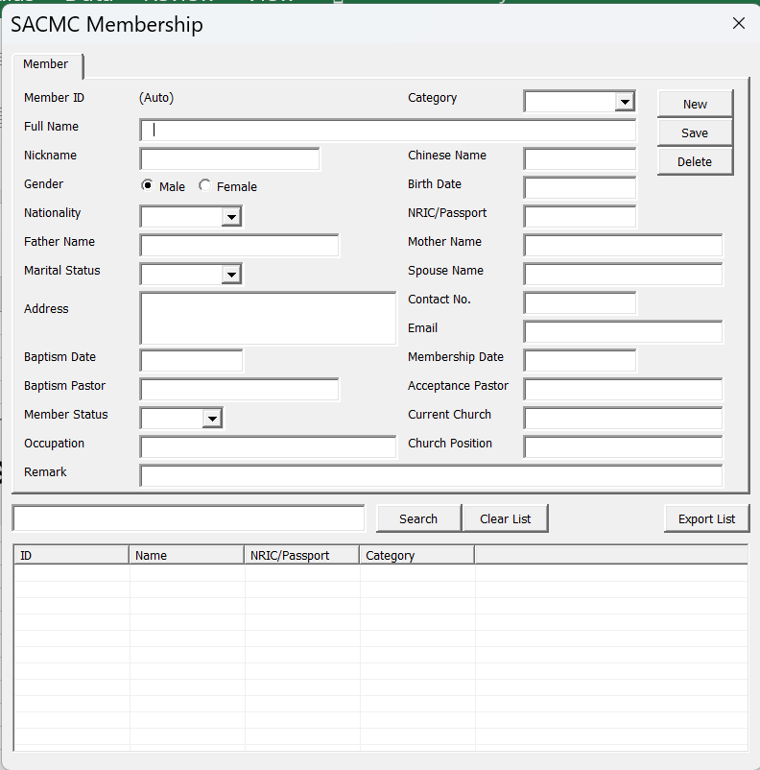
5) Membership Database completed

Slide 11
6) Filter up Membership List
- Active Membership List
- Inactive Membership List
- Active Probationary Members List
- Inactive Probationary Members List

Slide 12
Meeting End
Closing Prayer
Uncle Gan

