Slide 1
教会大楼进出手册
星期一至四，教会大门只在办公时间开放(8.30am-5.30pm)。星期五至星期日则全天开放。如果过了办公时间或非开放时段，可向教会守卫要求开门并在 “访客记录簿 “进行登记。
Monday to Thursday, church main door will be open during office hour (8.30am-5.30pm).
Friday to Sunday church main door will be open for whole day.
If after office hour or closed hour, kindly request with security guard to open door & register at “visitor record book “.
温馨提醒 : 最后的人请关灯关门。
Note : Last to leave, Please turn off the lights and close the door.

Slide 2
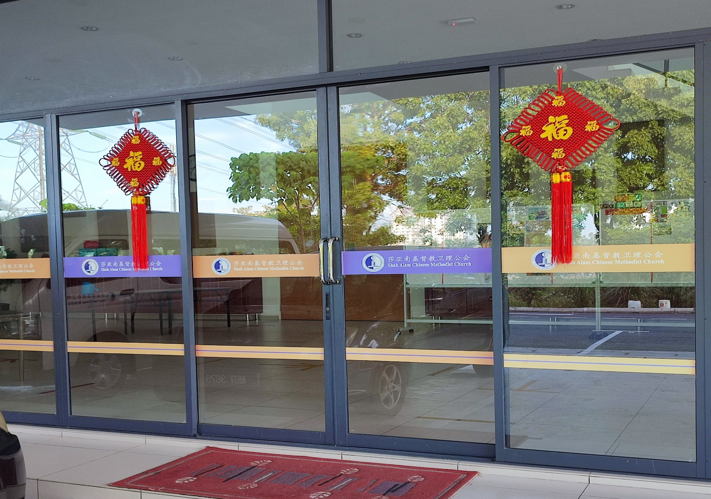
Church Main Door 教会大门

