Slide 1
Sunday School Class Arrangement Year 2025
Class Room | Standard / Form | Age | No. of Students
Nursery Room | - | 3-6 years old | 18
Room 1 | Chinese Std 1-3 | 7-9 years old | 10
Room 2 | Chinese Form 1-2 | 13-14 years old | 10
Room 3 | Chinese Form 3-5 | 15-17 years old | 9
Room 4 | English Std 1-3 | 7-9 years old | 9
Room 5 | English Std 4-6 | 10-12 years old | 11
Room 6 | English Form 3-5 | 15-17 years old | 11
Room 7 | Chinese Std 4-6 | 10-12 years old | 7
Room 8 | English Form 1-2 | 13-14 years old | 9

Slide 2

Chinese / English
( 3 - 6 Years Old )
Teachers :-
1) Jessie Un / Tracy Un / Kim Un
2) Wen Lin / Zi Lin / Ke Lin
3) Christine / Swee Yee / Su San

Slide 3
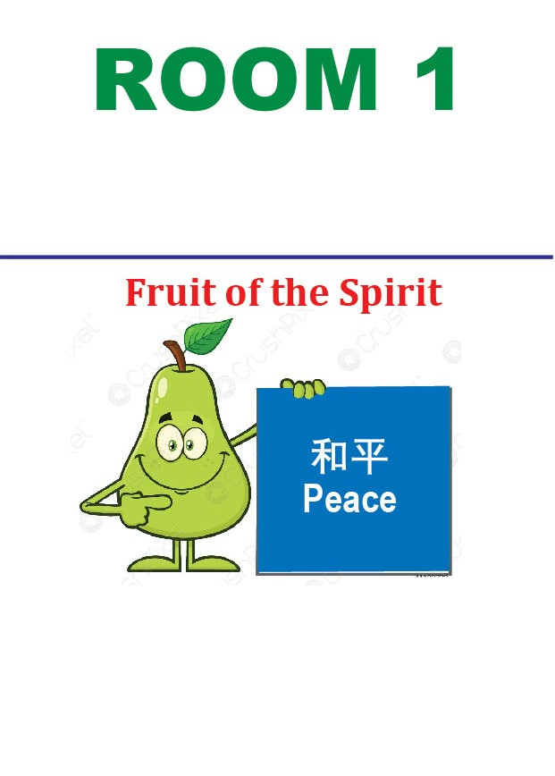
Standard 1-3 (Chi)
( 7-9 Years Old )
Teachers :-
1) Debbie Un / Audrey Un
2) Suanne Yap / Desiree Lai
3) Josiah Kuan / Victor Chang

Slide 4
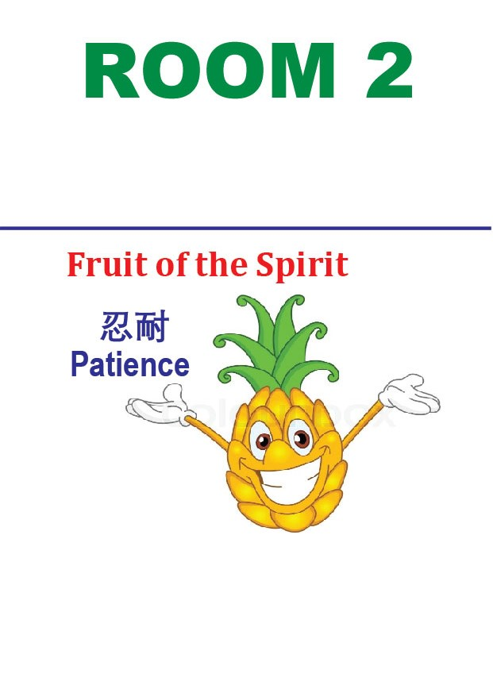
Form 1-2 (Chi)
( 13-14 Years Old )
Teachers :-
1) Doreen Teoh
2) Joyce Yeoh
3) Jane Lee

Slide 5

Form 3-5 (Chi)
( 15-17 Years Old )
Teachers :-
1) Peter Leong
2) Caleb Lai
3) Joshua Ng

Slide 6
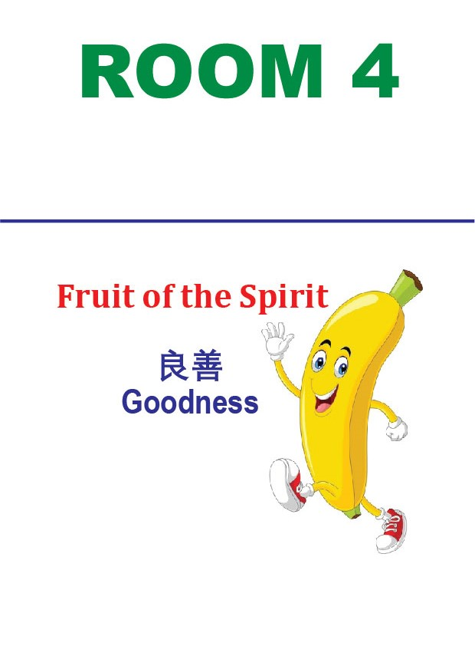
Standard 1-3 (Eng)
( 7-9 Years Old )
Teachers :-
1) Priscilla / Valerie
2) Lynn
3) Elise Kuan / Jaelyn

Slide 7

Standard 4-6 (Eng)
( 10-12 Years Old )
Teachers :-
1) Helen Poh
2) Jenny Law
3) Angeline Dewy

Slide 8
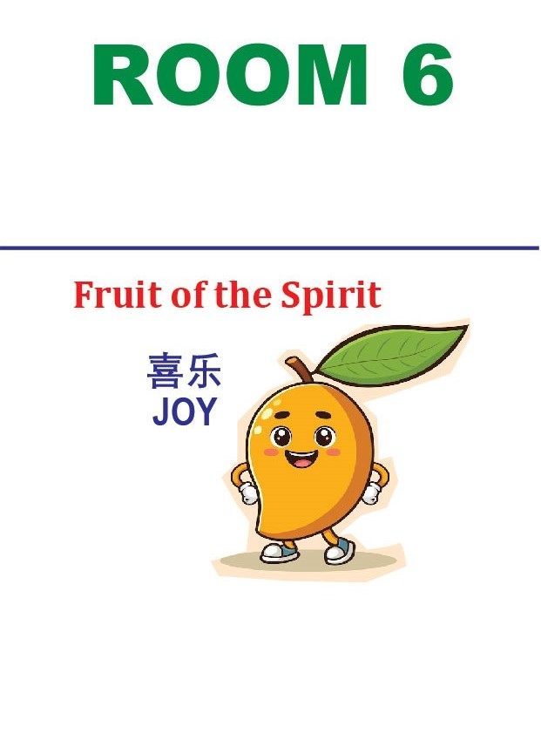
Form 3-5 (Eng)
( 15-17 Years Old )
Teachers :-
1) Liew Choy Nyok
2) William Poh / Andrew Ding
3) Alan Boey

Slide 9

ROOM 7
Standard 4-6 (Chi)
Kindness
恩慈
( 10-12 Years Old )
Teachers :-
1) Mavis Tang
2) Tiew Kien Hui
3) Ong Bee Yong

Slide 10

ROOM 8
Form 1-2 (Eng)
Gentleness
温柔
( 13-14 Years Old )
Teachers :-
1) Juliana Wong
2) Sandra Liew
3) Edmund Fong

Slide 11
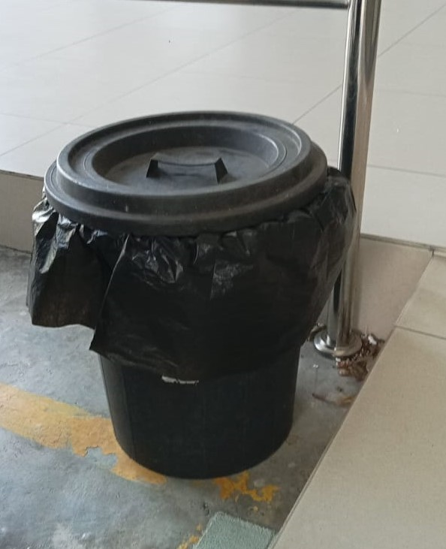
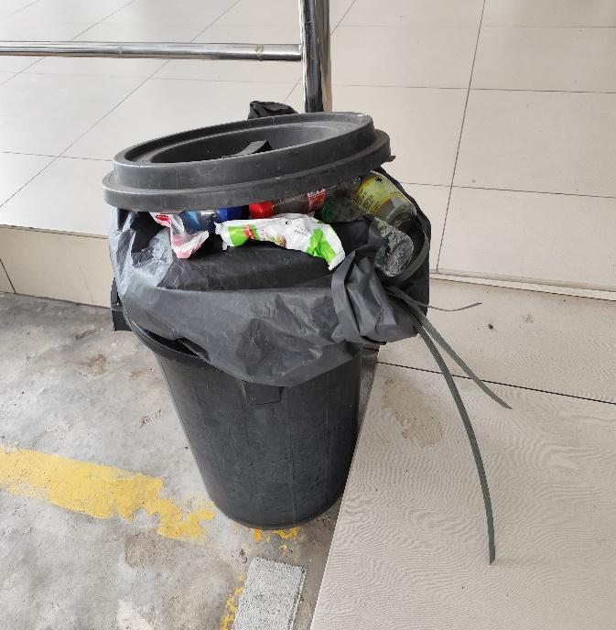
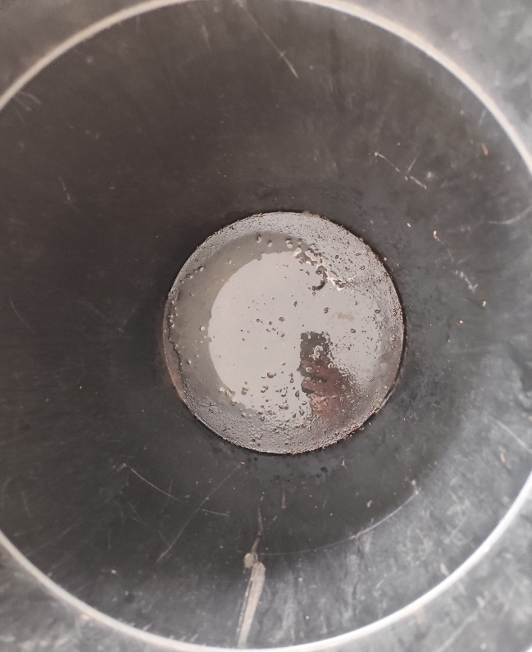
X 没有食物垃圾
Flying Insects
垃圾虫

Slide 12
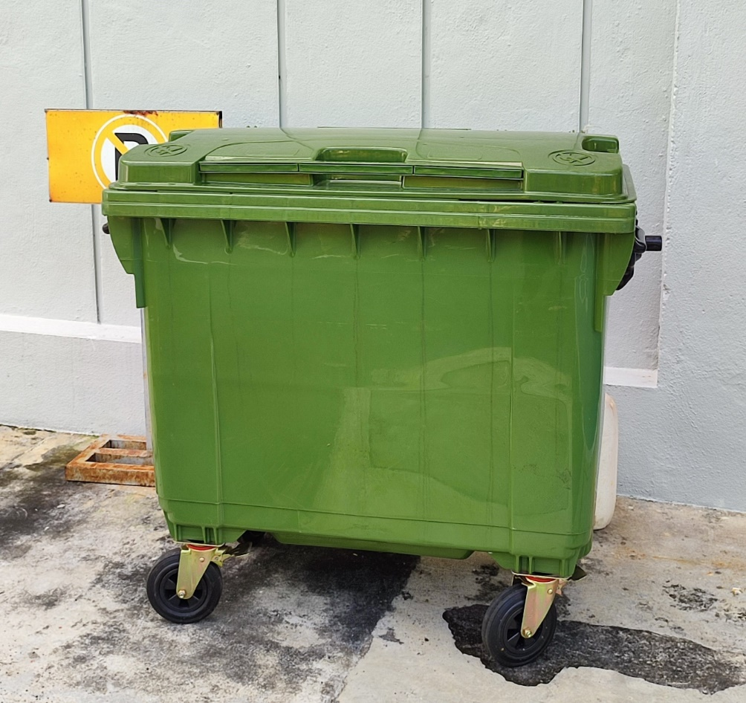
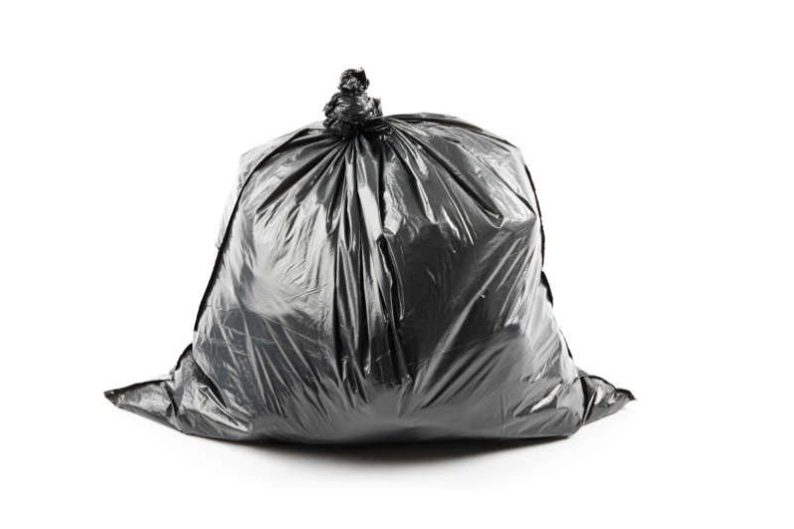
青色垃圾桶
食物垃圾打包好

Slide 13
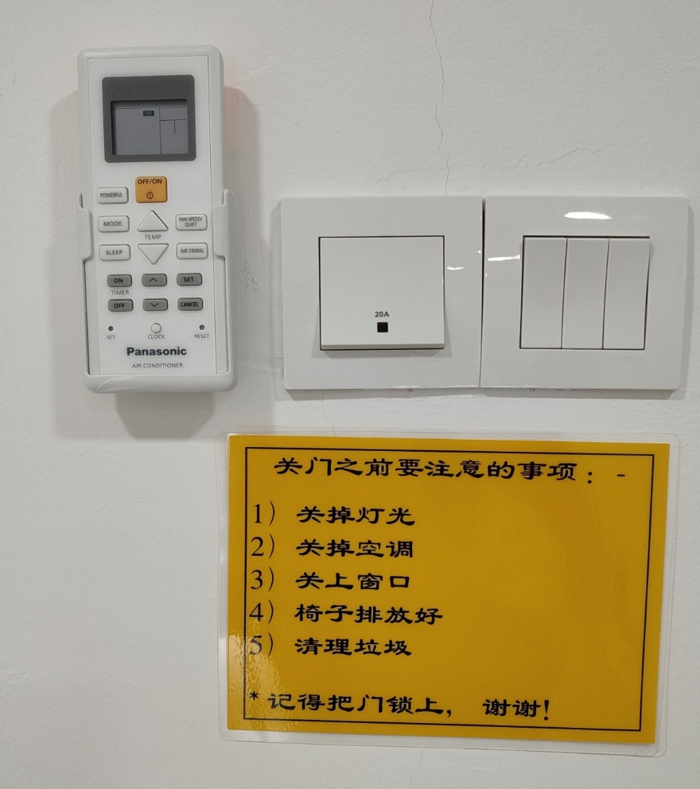
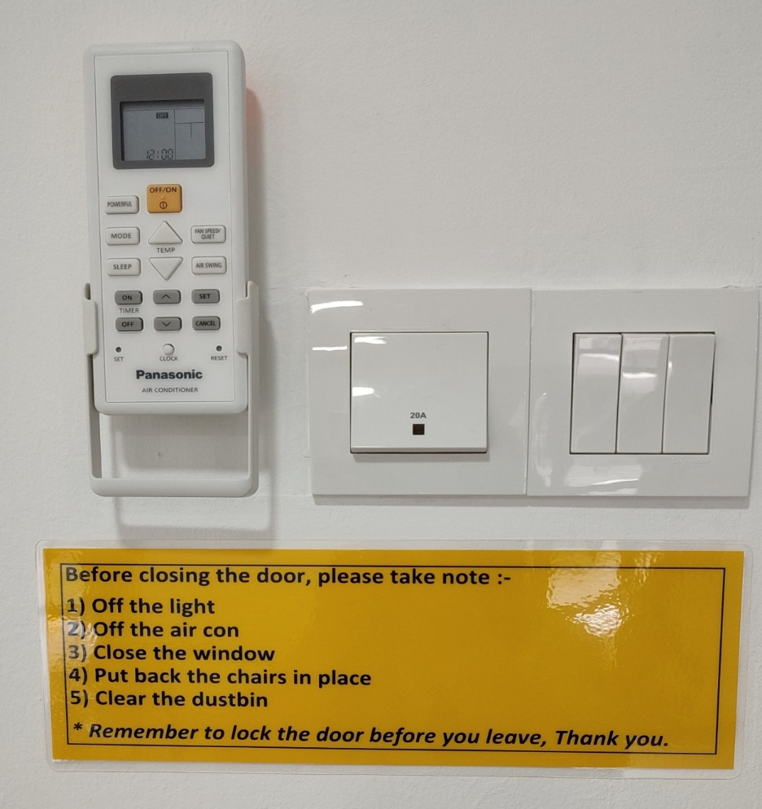
温馨提醒

Slide 14
S.S Class Room Password Number
Room 1 = 1231
Room 2 = 2064
Room 4 = 7893
Room 5 = 0125

