Slide 1

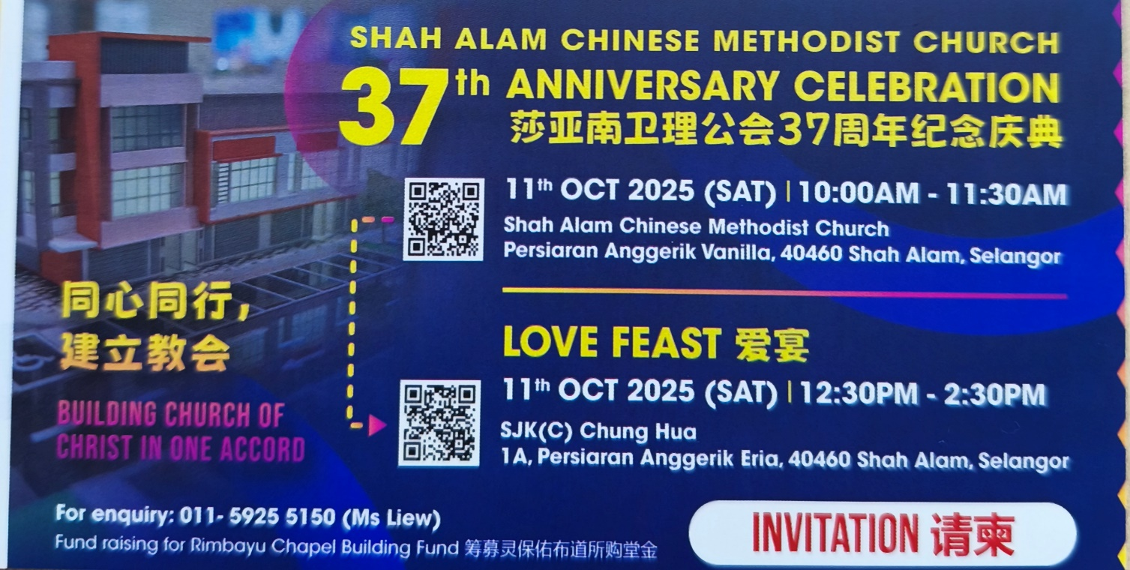
爱宴餐劵
Anniversary Lunch
  Date : 11th OCT 2025
Time : 12.30pm ~ 2.30pm

