Slide 1
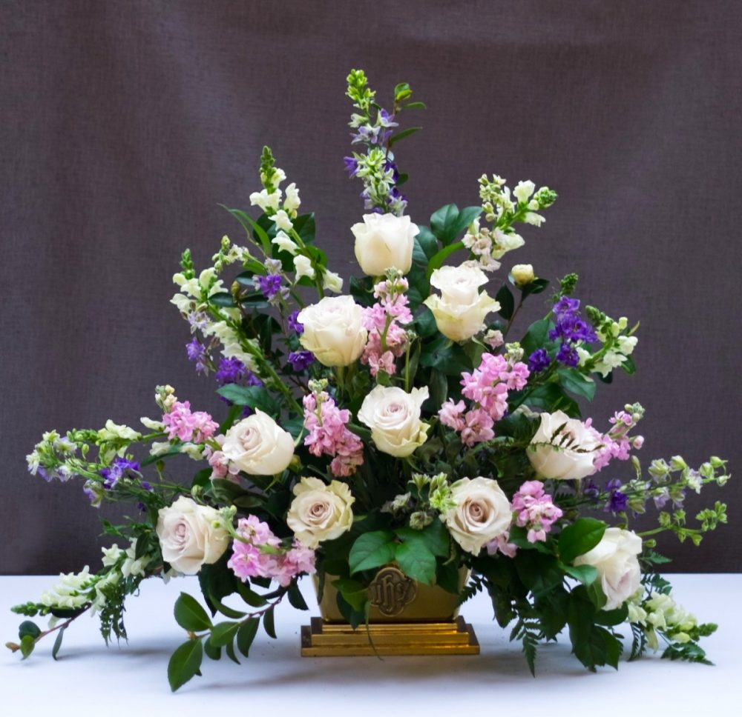
FLOWER OFFERING
献花
Year 2024
@ RM50
* 献花钱请交给凤仪姐妹

