Slide 1
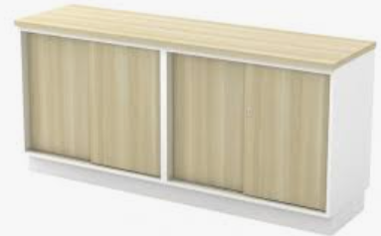
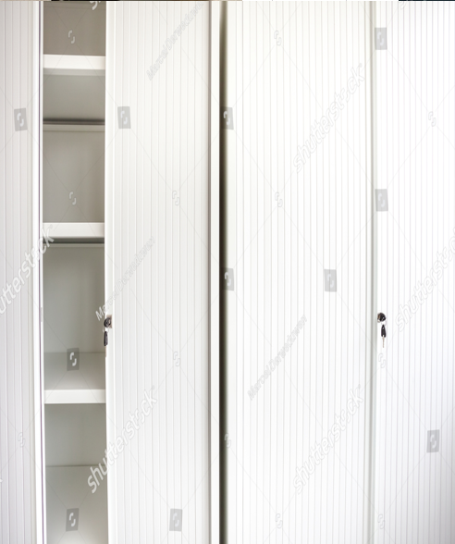
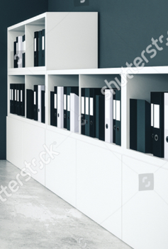
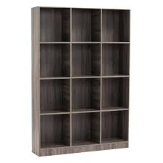
Air cond
Cabinet sliding door
window
Table HY
cabinet
Bookshelf Cabinet
Entrance door
Cabinet sliding door
window
Table Rev.
Key storge
Air cond

