Slide 1
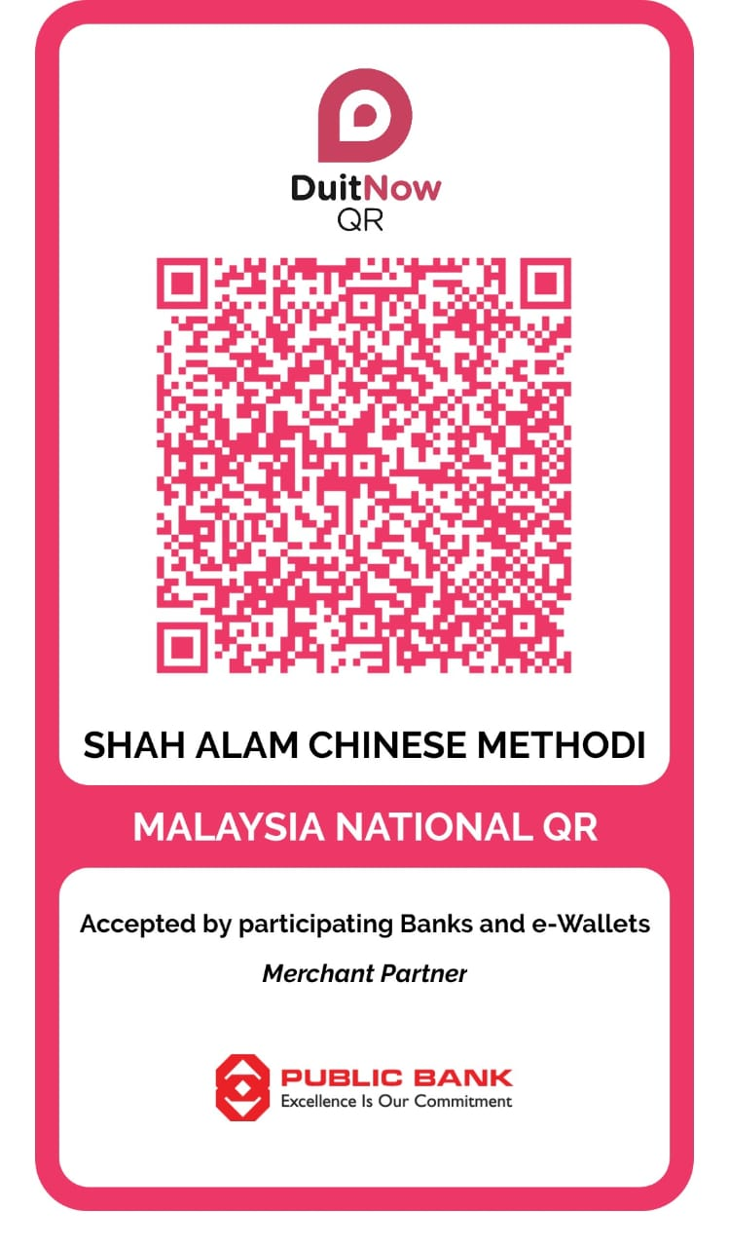
SHAH ALAM CHINESE METHODIST CHURCH

Slide 2
W = Worship 主日崇拜
当天崇拜中通过扫描QR码的奉献将归入当天主日的收款额。
Contributions made through QR code Scanning during the worship service will be recorded as the offering received on the same Sunday.

Slide 3
请您表明以下代号对应的汇款奉献。
Please specify the contribution of the remittance corresponding to the following code.
W = Worship 主日崇拜
T = Tithe 十一奉献
TG = Thanksgiving 感恩奉献
MF = Mission Fund 宣教奉献
BF = Building Fund 建堂奉献
CF = Commitment Fees 年会承担

Slide 4
如果您是要汇款去灵保佑教会的建堂奉献, 请使用转账户口的方式。
If you wish to make a contribution to Rimbayu church via a bank transfer, please use the following a/c details.
银行户口号码 Bank A/C No:
Rimbayu Methodist Church
PBB 3239505209
Rimbayu = Building Fund 建堂奉献

Slide 5
如果您想通过户口转账，以下是
银行户口号码：-
If you wish to make a transfer via bank account, below are the bank account details:-
SHAH ALAM CHINESE METHODIST CHURCH
PBB 3200440200
温馨提醒
“ 请您表明代号对应的汇款奉献 ”

