Slide 1
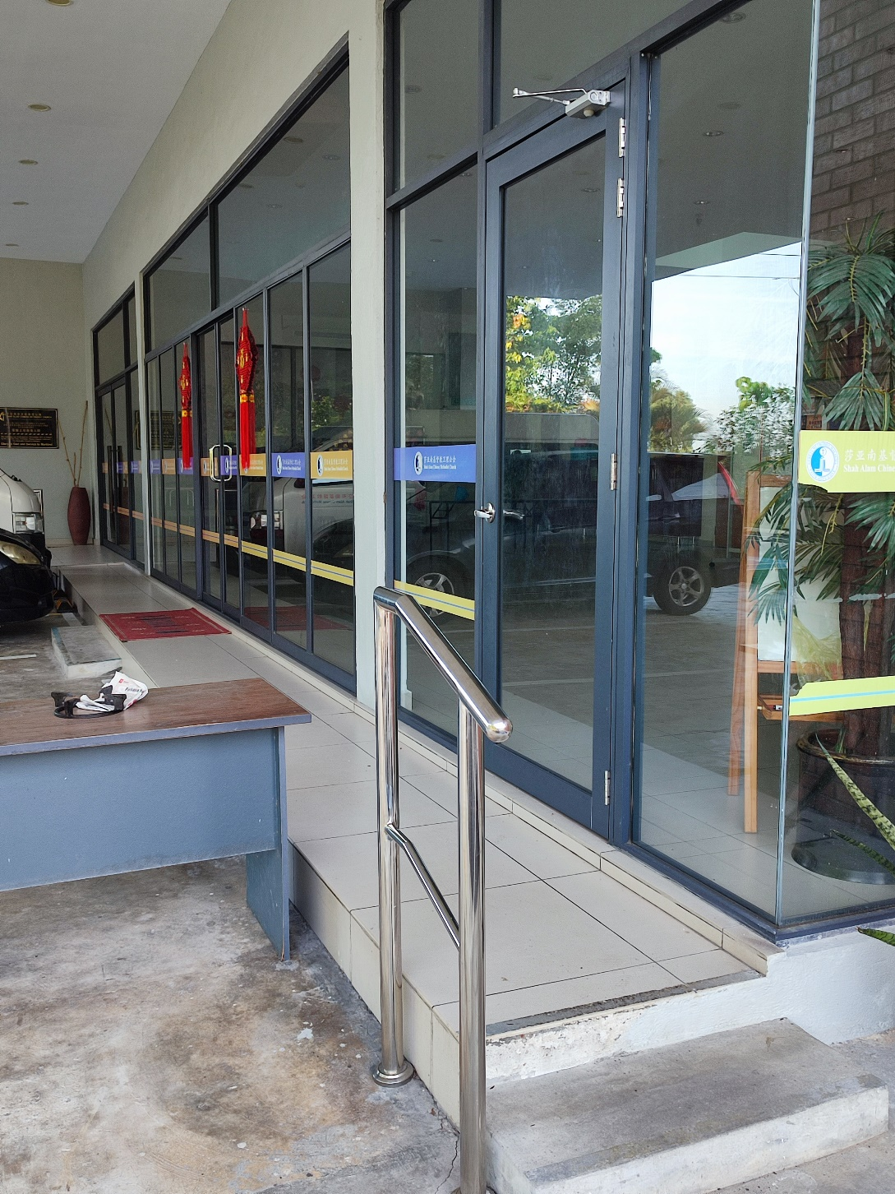
星期一至星期四
此门将会在下午6时锁上
Monday - Thursday
These door will be locked at 6pm
** 早上8时将会开门
** Will open at 8am

Slide 2
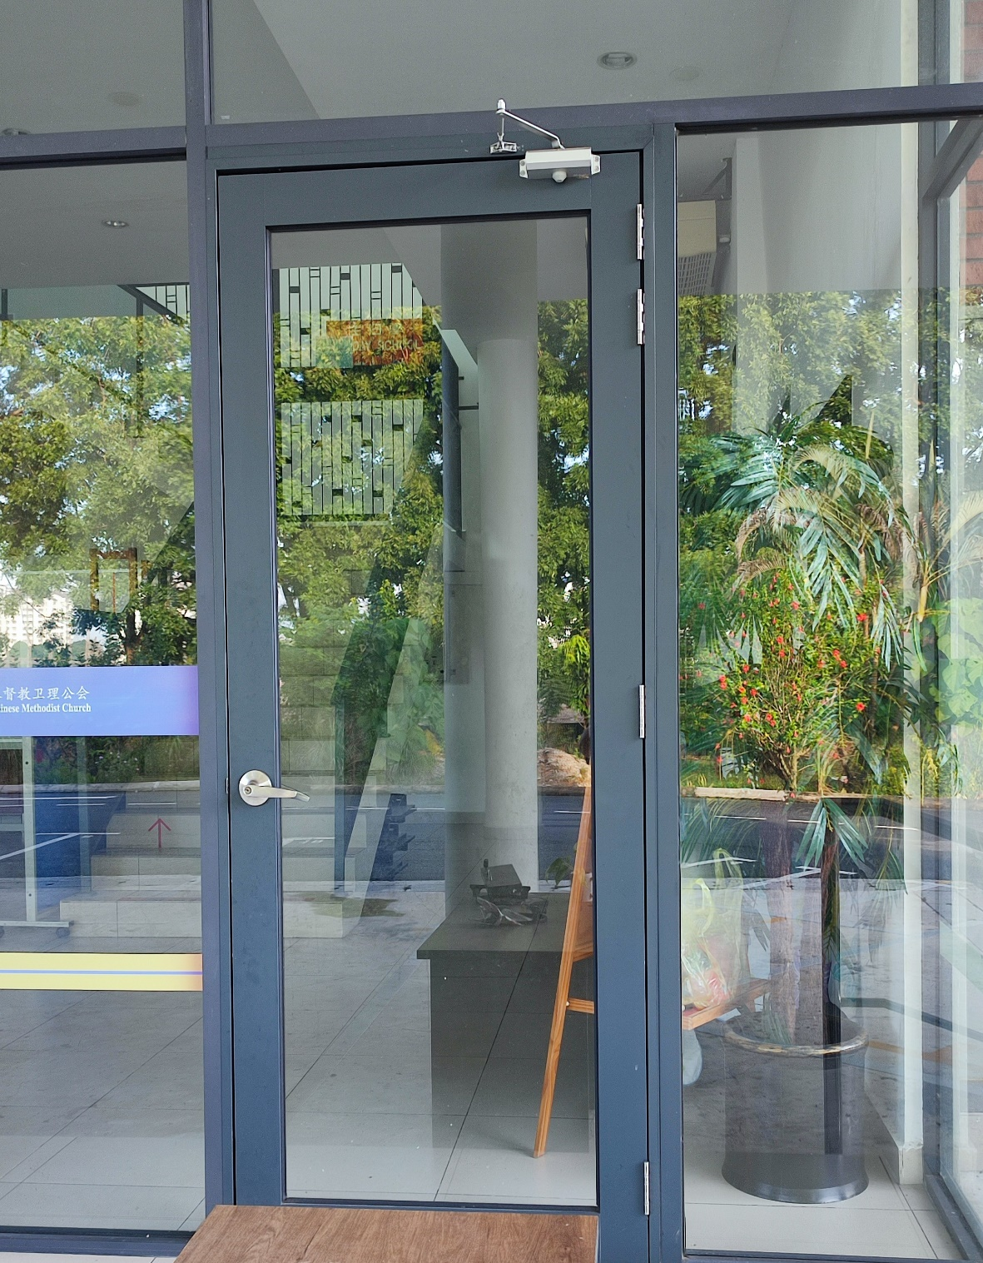
只能使用这门进入
Can only use this door to enter
请到保安处拿锁匙
Collect door key at guard house
完毕后请把锁匙交回保安处
When finished, Please return the key to guard house

Slide 3
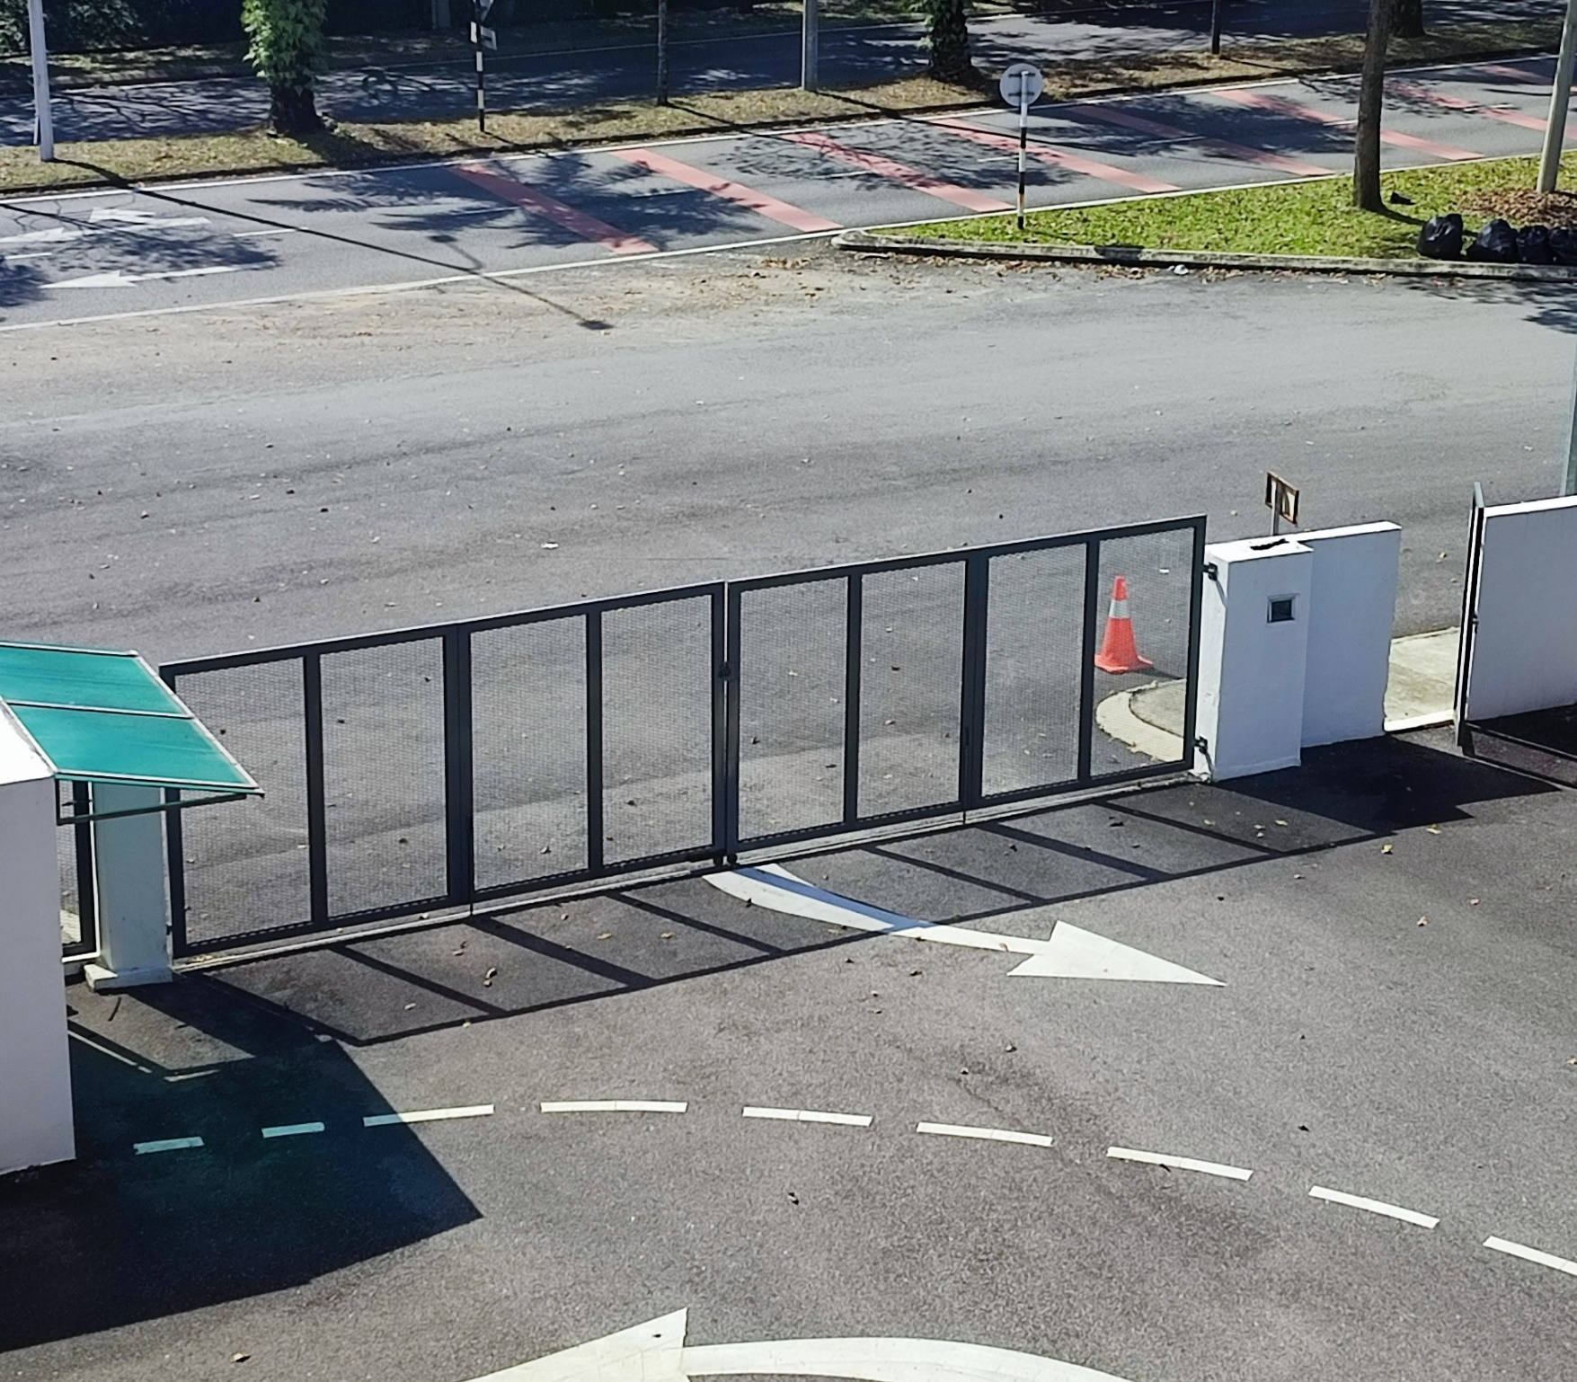
星期一至星期五
Monday - Friday
当你进入时。。。
When you enter …

Slide 4
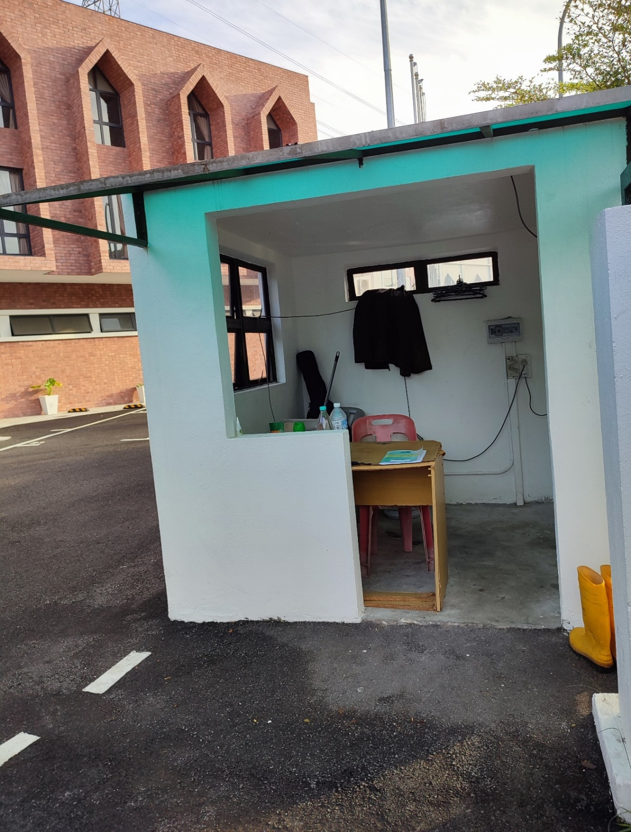
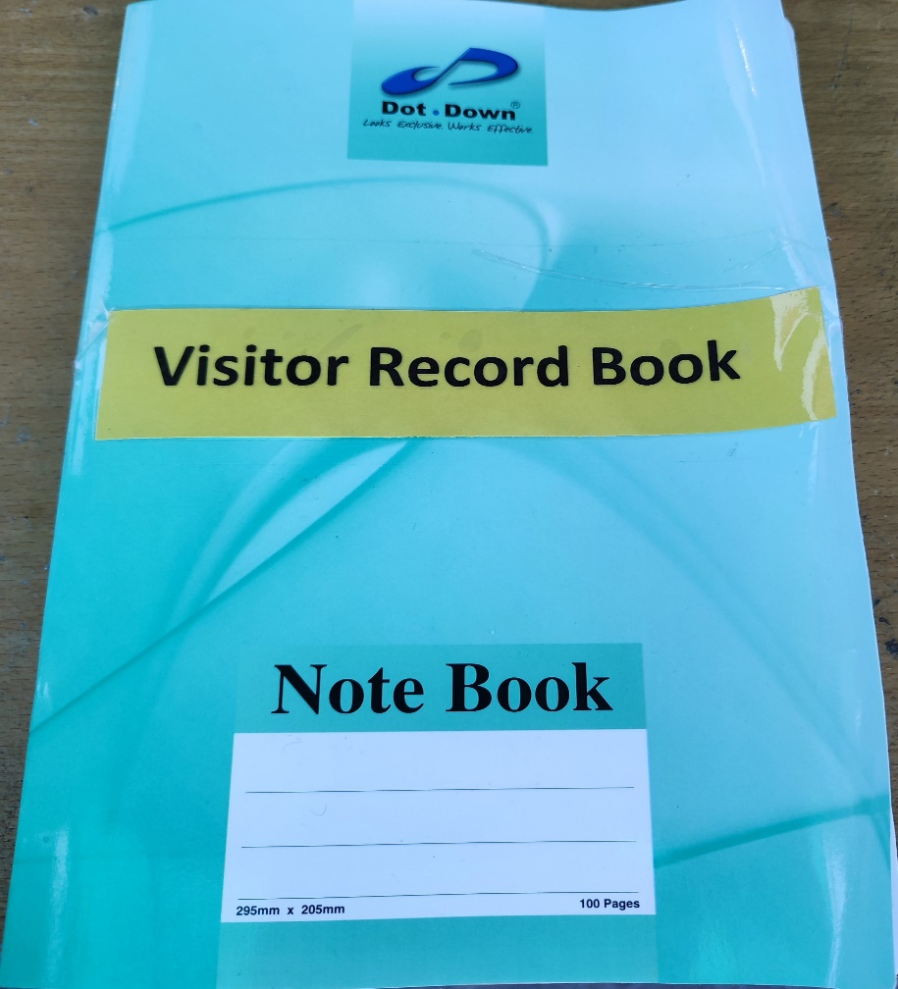
请在保安处登记
Please register at the security desk

