Slide 1

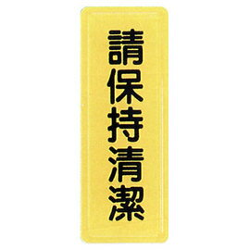


温馨提醒
不可把婴儿尿片丢在此处,
请自行处理。
Do not leave baby diapers here, please dispose of them yourself.

